Slide 1
Energy’s Impact on Air Pollution
Andre Shearer, Erich Mitchell, Felix Pronove, Justynn Hammond, Kim Christensen, Lisa Caruana
Notes:
Felix

Slide 2
What we examined
Relationship between energy sources and air pollution.
QUESTION: Does an increase in renewable energy production reduce the air pollution levels?
Hypothesis: An increased use of renewable energies results in less air pollution.
Potential pitfall: Delayed effect of energy use on air pollution (i.e. energy used 2000 -> air pollution 2005)
Notes:
Justynn

Slide 3

Data Sources
EIA CSV file for energy production by source
Broken down by region & state
EPA API -- Breaks down air pollution across US
Notes:
Kim

Slide 4

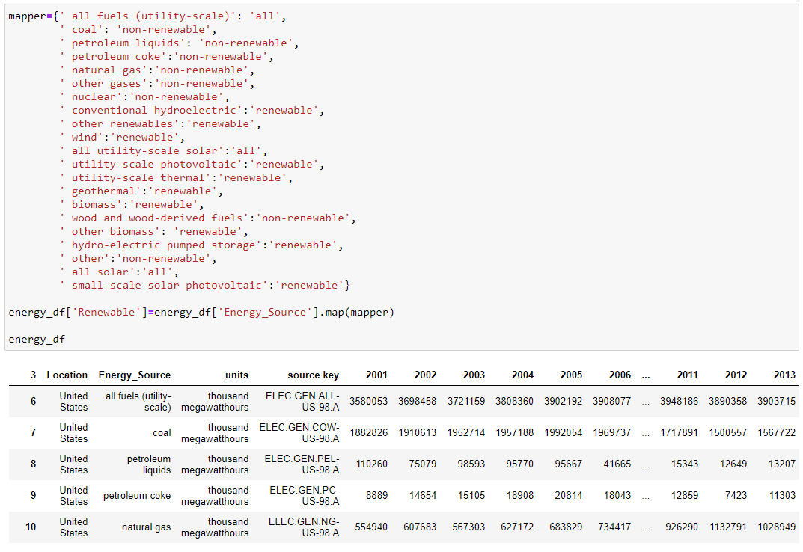
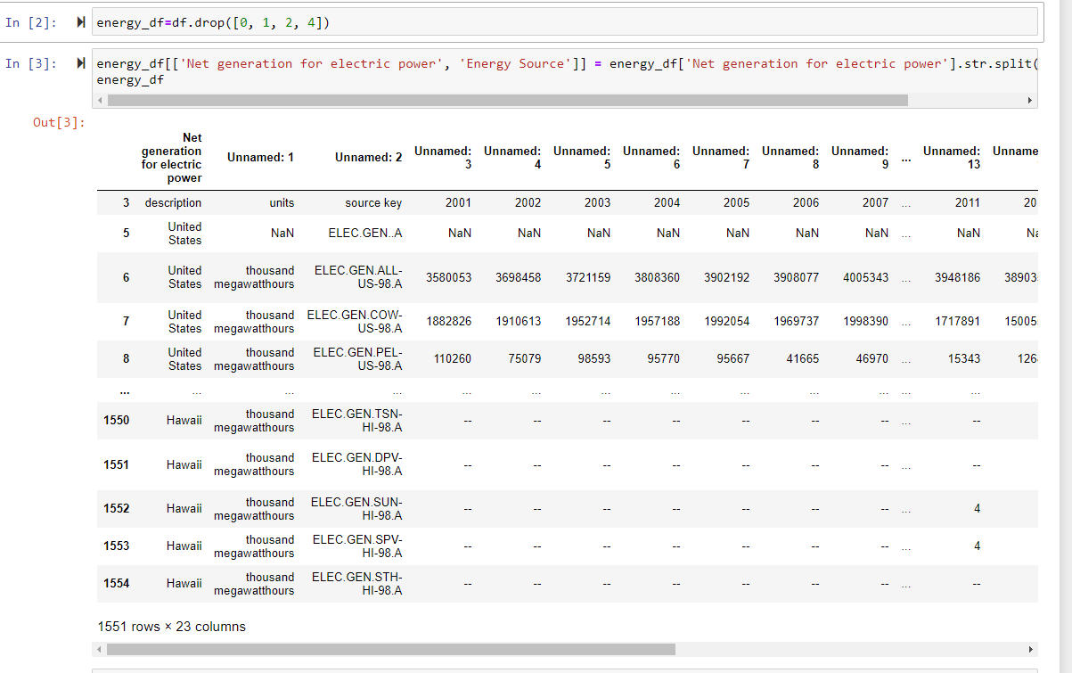
Notes:
Felix

Slide 5


API CALL - EPA Pollution Data
Only able to pull one year at a time
Had to pull each state by state code
Notes:
Mitch

Slide 6
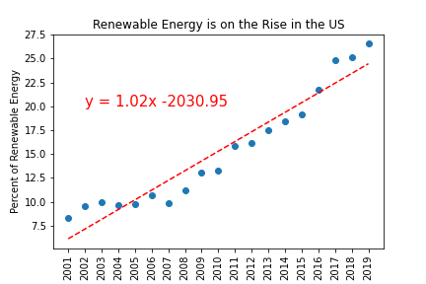
Renewable Energy Trends US
Renewable energy is increasing at 1.02% per year. At this rate, the US will reach 100% renewable energy in 2089. The forecasted renewable energy in 2020 is 25.47% and 26.49% in 2021.
Notes:
Kim

Slide 7
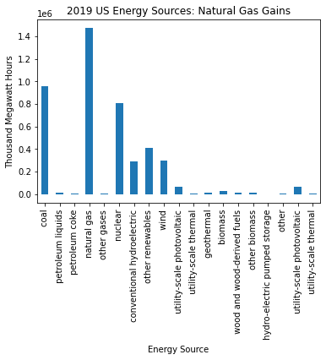
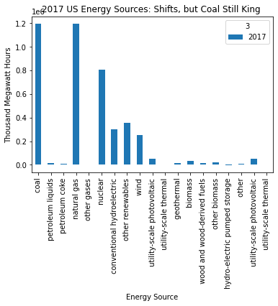
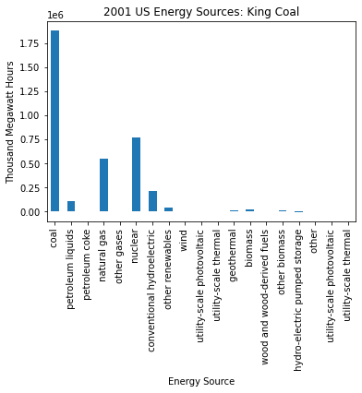
US Energy Production Trends
More efficient extraction methods have resulted in increases in natural gas production from shale and other geologic sources that were previously inaccessible.
While the US has made gains in renewable energy sources, production is still so heavily reliant on coal as to make it difficult to show all energy sources on the same chart.
Notes:
Lisa

Slide 8
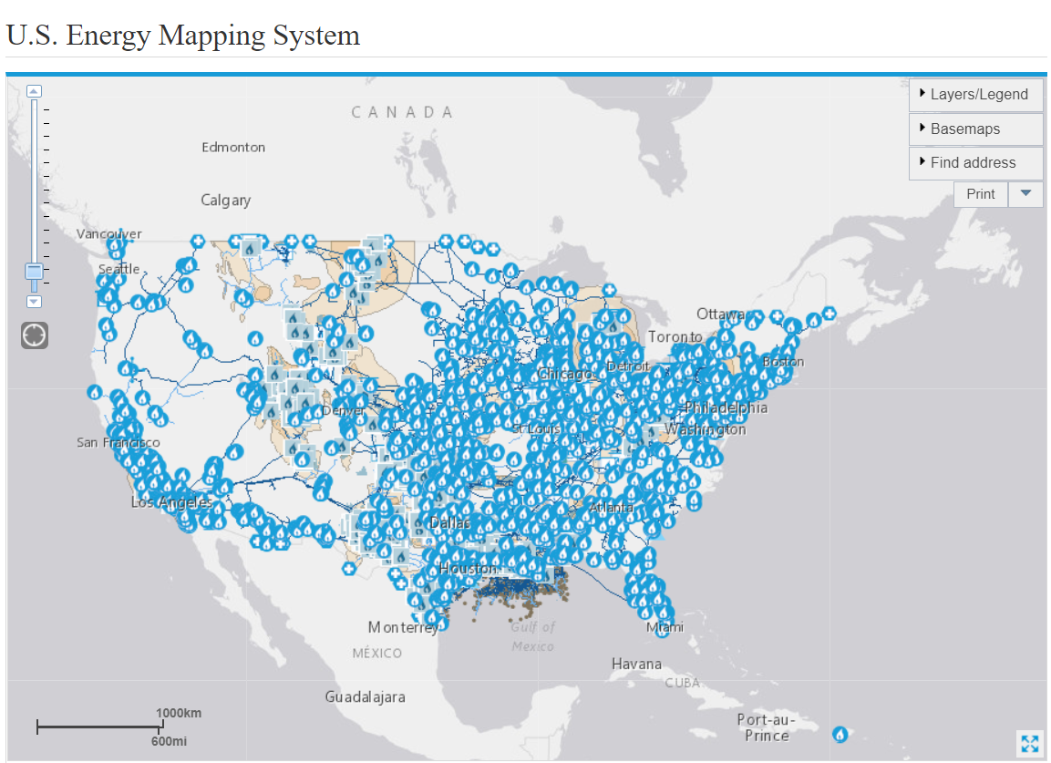
US Natural Gas Pipelines
Source: https://www.eia.gov/state/maps.php
Notes:
Justynn

Slide 9
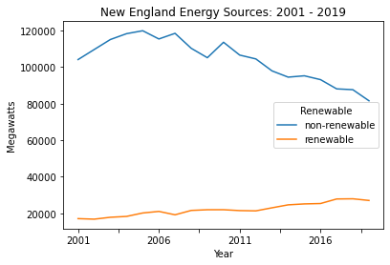
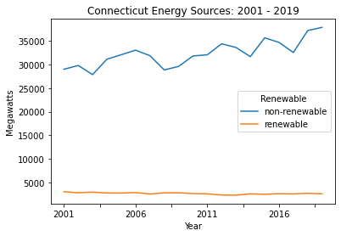
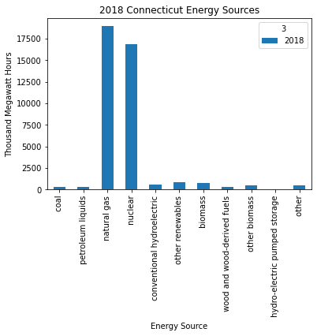
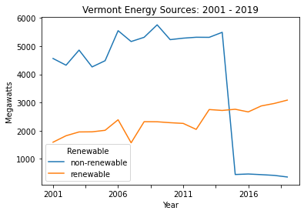
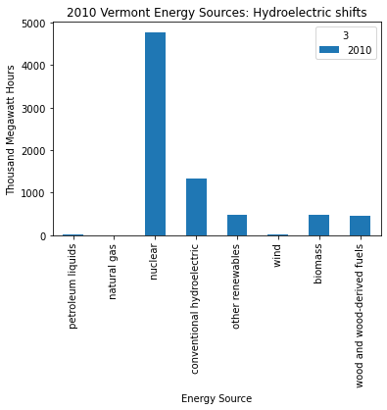
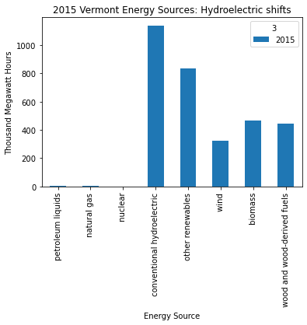
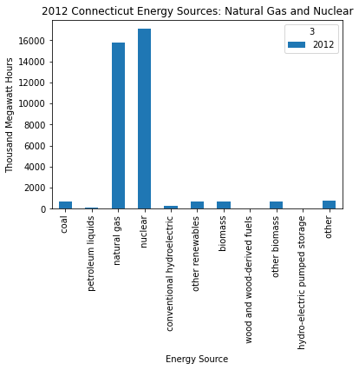
New England Region Energy Trends
Connecticut
Maine
Massachusetts
New Hampshire
Rhode Island
Vermont
Importance of Place and Policy
Vermont and Connecticut do not have any fossil fuel energy reserves.
2016 Vermont Comprehensive Energy Plan and the shutdown of the Yankee Nuclear Power Station in 2014 resulted in a drastic shift in energy sources.
Largest share of electricity in Vermont comes from hydropower in Canada, which has its own environmental impacts.
Notes:
Lisa

Slide 10
Mountain Region Energy Trends
The Mountain region is classified in by EIA as containing the following states:
Arizona
Colorado
Idaho
Montana
Nevada
New Mexico
Utah
Wyoming
Over the 2001-19 period, the Mountain region had higher renewable energy as a percent of total production (19%), than the nation as a whole (16%).
The Mountain state with the highest percentage renewable energy production is Idaho, with about 85% of its energy being renewable. This is due to hydroelectric power infrastructure.
Similar to other regions, the Mountain region is dependent primarily on coal (51% of production), and natural gas (21% of production)
Notes:
Felix

Slide 11
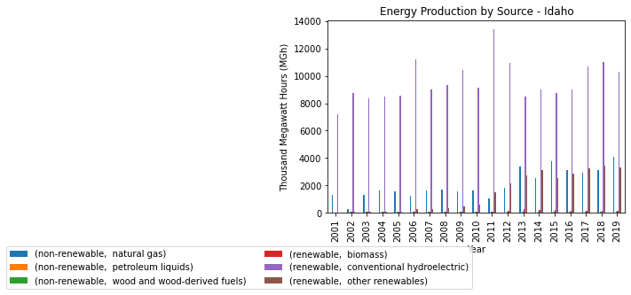
Idaho Energy Use
Notes:
Felix

Slide 12
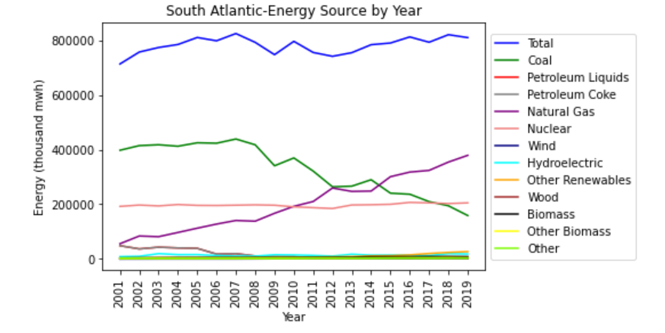
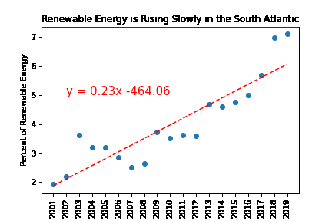
South Atlantic Energy Trends
Moving from coal-powered to natural gas in this region, but renewables are rising slowly.
At this rate, it will take until 2452 for the South Atlantic region to reach 100% Renewable Energy.
Notes:
Kim

Slide 13
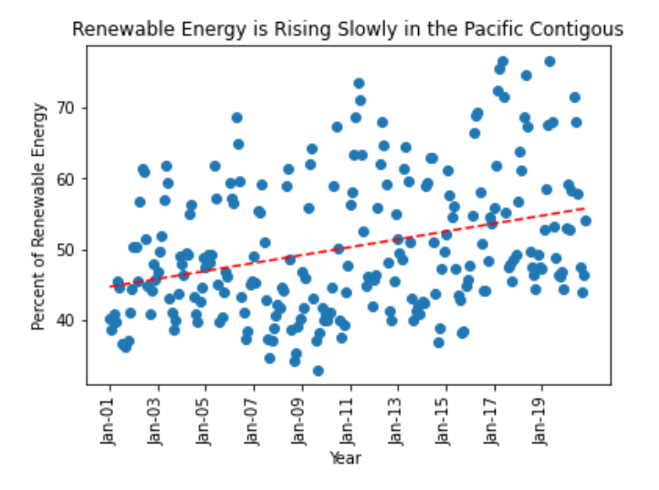
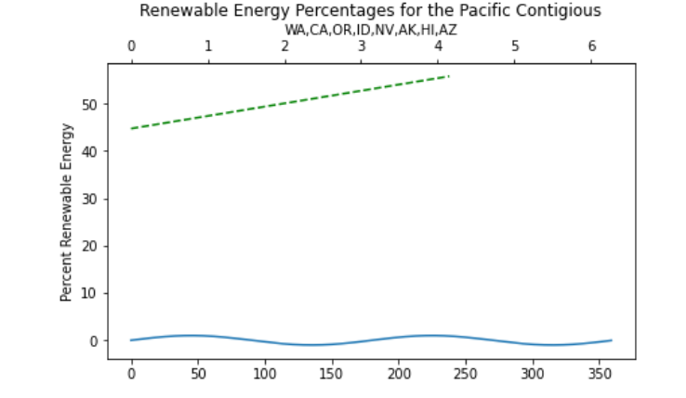
Pacific Coast Energy Trends
Notes:
Justynn

Slide 14
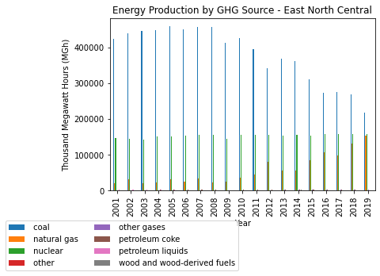
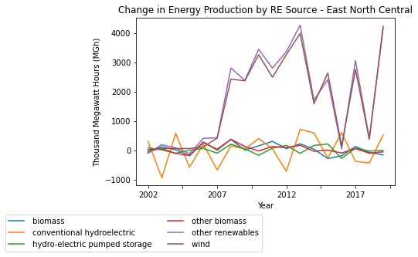
East Midwest Energy Trends
Coal overwhelmingly primary energy source
Natural gas 2nd
Wind & other renewables (solar, etc.) largest renewable
Notes:
Felix

Slide 15
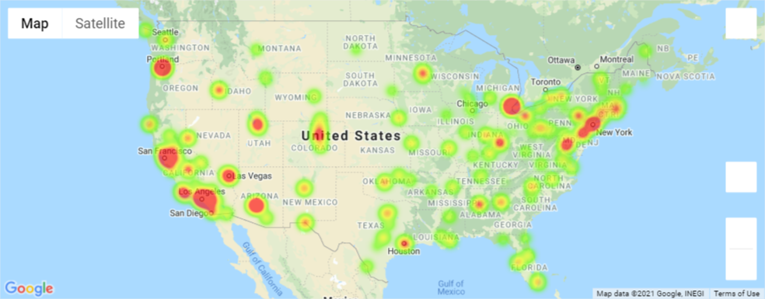
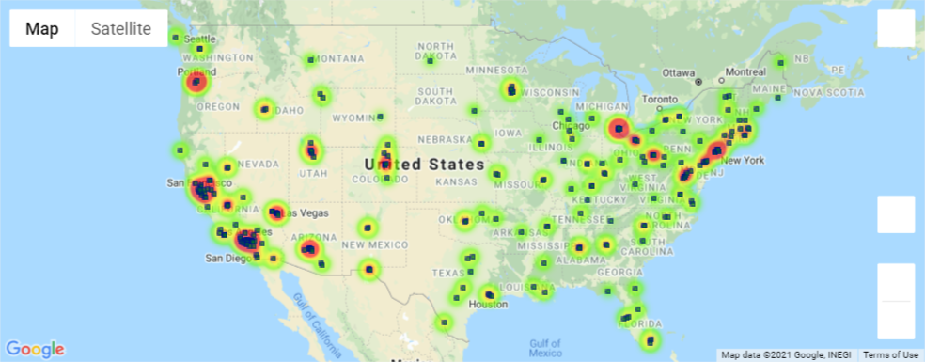
Air Pollution Trends
Largest source of CO is vehicles.
2020 Heatmap of US Carbon Monoxide readings in PPM. Heatmap readout can appear skewed due to monitoring locations.
Notes:
Mitch

Slide 16
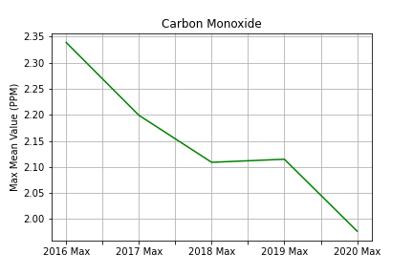
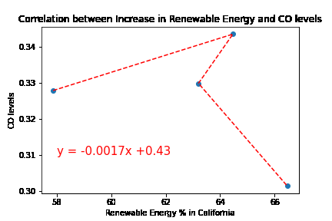


Does energy source impact air pollution?
CONCLUSION
Although, US has made strides in moving towards renewables, still heavily dependent on Coal and Natural Gas
Correlation between increase in Renewable Energy and CO levels in CA is -0.351, indicating a weak negative relationship.
2016 V 2020
Notes:
Felix (+group for vamp)

Slide 17
Analysis & Challenges
Challenges:
API calls for 1 year at a time
CSV file required a massive amount of cleaning/data formatting
Additional Analysis:
COVID changes to environmental pollution
Look at different pollutants
Move to renewable energy -- challenges with energy storage
Notes:
Lisa

